Slide 1


Slide 2

Major Project – I (01CE0716)
Review 1 (29/07/2024)
WEATHER FORECAST APP
Team ID: 7CE_MP_042
Team Member 1: TEJ DEKIWADIYA (92100103011) (TC2)
Team Member 2: KRUTI VADALIYA (92100103349) (TC4)
Team Member 3: MOHIT KARIA (92100103401 ) (TC4)
Guided By
Internal Guide Name: Prof. Harsh Nagar
Department of Computer Engineering, Faculty of Technology

Slide 3
Outline
Introduction
Abstract
System Analysis
ER Diagrams
Proposed Solution
Project Flow Chart
Tools & Technology to be used
Gantt Chart
Expected Outcomes
References

Slide 4
Introduction
The Weather Forecast App is a dynamic web application built using the MERN stack (MongoDB, Express.js, React.js, and Node.js).
It allows users to check real-time weather conditions for various locations worldwide. The app fetches weather data from an external API and displays detailed forecasts, including temperature, humidity, and wind speed.
Users can search for specific cities, view current weather conditions, and get updates on upcoming weather trends.
The responsive design ensures a seamless user experience across devices. MongoDB stores user preferences and search history, while Express.js and Node.js handle server-side operations. React.js powers the interactive front-end, providing a smooth and intuitive interface.

Slide 5
Abstract
The Weather Forecast Web Application is an innovative digital platform designed to provide users with accurate, real-time weather information. This application leverages advanced meteorological data from reliable sources to deliver precise forecasts, ensuring users are well-prepared for any weather conditions. The core functionality includes current weather conditions, and extended forecasts for up to five days.
Utilizing a user-friendly interface, the web app offers intuitive navigation and a visually appealing design, making it accessible to users of all technical backgrounds. Key features include interactive maps displaying weather patterns, radar images, and severe weather alerts to keep users informed of potential hazards. Additionally, the app integrates geolocation services, enabling automatic detection of the user's location for localized weather updates.
The backend of the application is built using robust technologies to ensure scalability and reliability. Real-time data is fetched from weather APIs, processed, and presented in a concise format. The front end employs responsive design principles, ensuring optimal performance across various devices, including desktops, tablets, and smartphones.
In summary, the Weather Forecast Web Application is a comprehensive tool designed to provide accurate, real-time weather information with a focus on user experience, reliability, and data security. It serves as an essential resource for individuals seeking to stay informed about weather conditions, ultimately helping them make better decisions in their daily lives

Slide 6
System Analysis
Architecture: The application employs a client-server architecture. The backend is built using robust server-side technologies (e.g., Node.js) to handle data processing and API requests. The frontend uses responsive design principles, utilizing HTML, CSS, and JavaScript frameworks like React.js.
Data Sources: The application integrates with third-party weather APIs (e.g., OpenWeatherMap, WeatherStack) to fetch real-time weather data. It uses geolocation services to provide localized weather updates.
Database: A database system (e.g., MongoDB) stores user preferences, historical weather data, and other relevant information.
Security Measures: The system implements HTTP for data transmission, user authentication, and encryption to the data.
Frontend Development: The user interface is developed using modern web technologies to ensure a seamless user experience across devices.
Backend Development: The server-side logic handles API requests, data processing, and communication with the database.
Maintenance and Updates: The system includes mechanisms for regular updates and maintenance to incorporate new features, improve performance, and address any security vulnerabilities

Slide 7
ER Diagrams
+-----------------+ +--------------------+ +-----------------+
| User | | WeatherData | | Feedback |
+-----------------+ +--------------------+ +-----------------+
| UserID (PK) |<--------------> | WeatherDataID (PK) |<--------------> | FeedbackID (PK) |
| Username | | Location | | UserID (FK) |
| Email | | Temperature | | WeatherDataID (FK) |
| Password | | Humidity | | Comment |
| ProfilePicture | | WindSpeed | | Rating |
| Preferences | | WeatherCondition | | CreatedAt |
| CreatedAt | | RecordedAt | +-----------------+
| UpdatedAt | | Forecast |
+-----------------+ +--------------------+

Slide 8
Proposed Solution
1. System Overview
The Weather Forecast Project aims to provide users with accurate and personalized weather information. The system includes user authentication, real-time weather data, a 5-day forecast, geographical location mapping, and generative AI for future weather predictions with recommendations and precautions.
2. System Architecture
Frontend: React.js & Tailwind for styling.
Backend: Node.js with Express.js for server-side logic.
Database: MongoDB for database management.
APIs: OpenWeatherMap API for weather data, Integrate React Leaflet Map Component use to show current location, Custom AI model for future weather predictions
3. Functional Requirements
User Authentication: Registration/Login Pages.
Weather Features: Display the current weather based on the user's city. 5-Day Forecast- Provide a 5-day weather forecast for the user's city. Integrate React Leaflet Map Component use to show current location.
Generative AI Predictions- Allow users to input any future date to get weather predictions, recommendations, and precautions.

Slide 9
Proposed Solution
4. System Components
Frontend:-
Login/Registration Pages:
- Form validation
- JWT authentication
Dashboard:
- Display current weather based on user’s city
- Show 5-day weather forecast
- Integrate React Leaflet Map Component use to show current location
- Input for future date to get AI-generated weather predictions
Database:-
User Collection:
- Stores user details, hashed passwords, and city
Weather Data Collection:
- Cache recent weather data for performance

Slide 10
Proposed Solution
Backend:-
User Management:
- RESTful API for registration and login
- Secure password storage with bcrypt
- JWT for session management
Weather Data Fetching:
- Fetch current weather and 5-day forecast using OpenWeatherMap API
- Cache data to minimize API calls
Geolocation Service:
- Integrate React Leaflet Map Component use to show current location on a map with weather condition
Generative AI Integration:
- Develop or integrate an AI model to predict future weather
- Provide recommendations and precautions based on AI predictions
5. Future Enhancements
Add user notifications for severe weather alerts
Implement social sharing features for users to share weather information

Slide 11
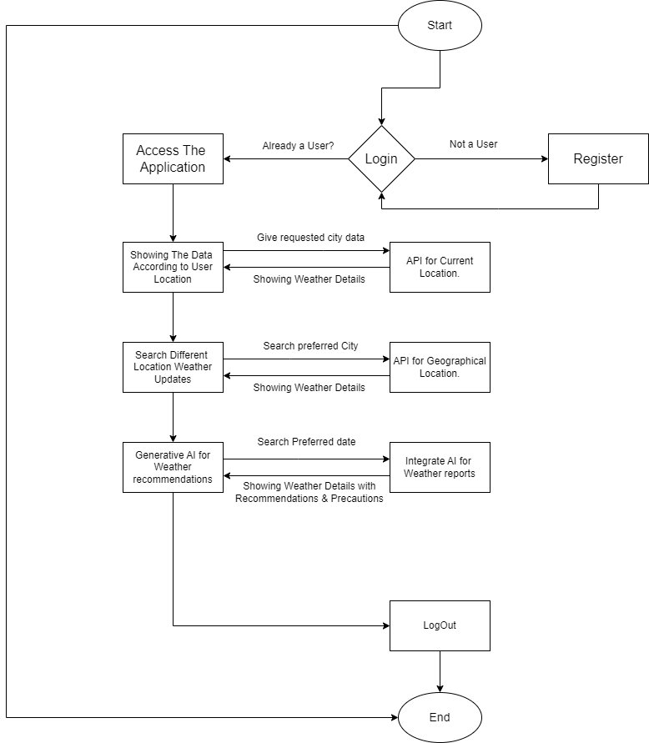
Flow Chart

Slide 12
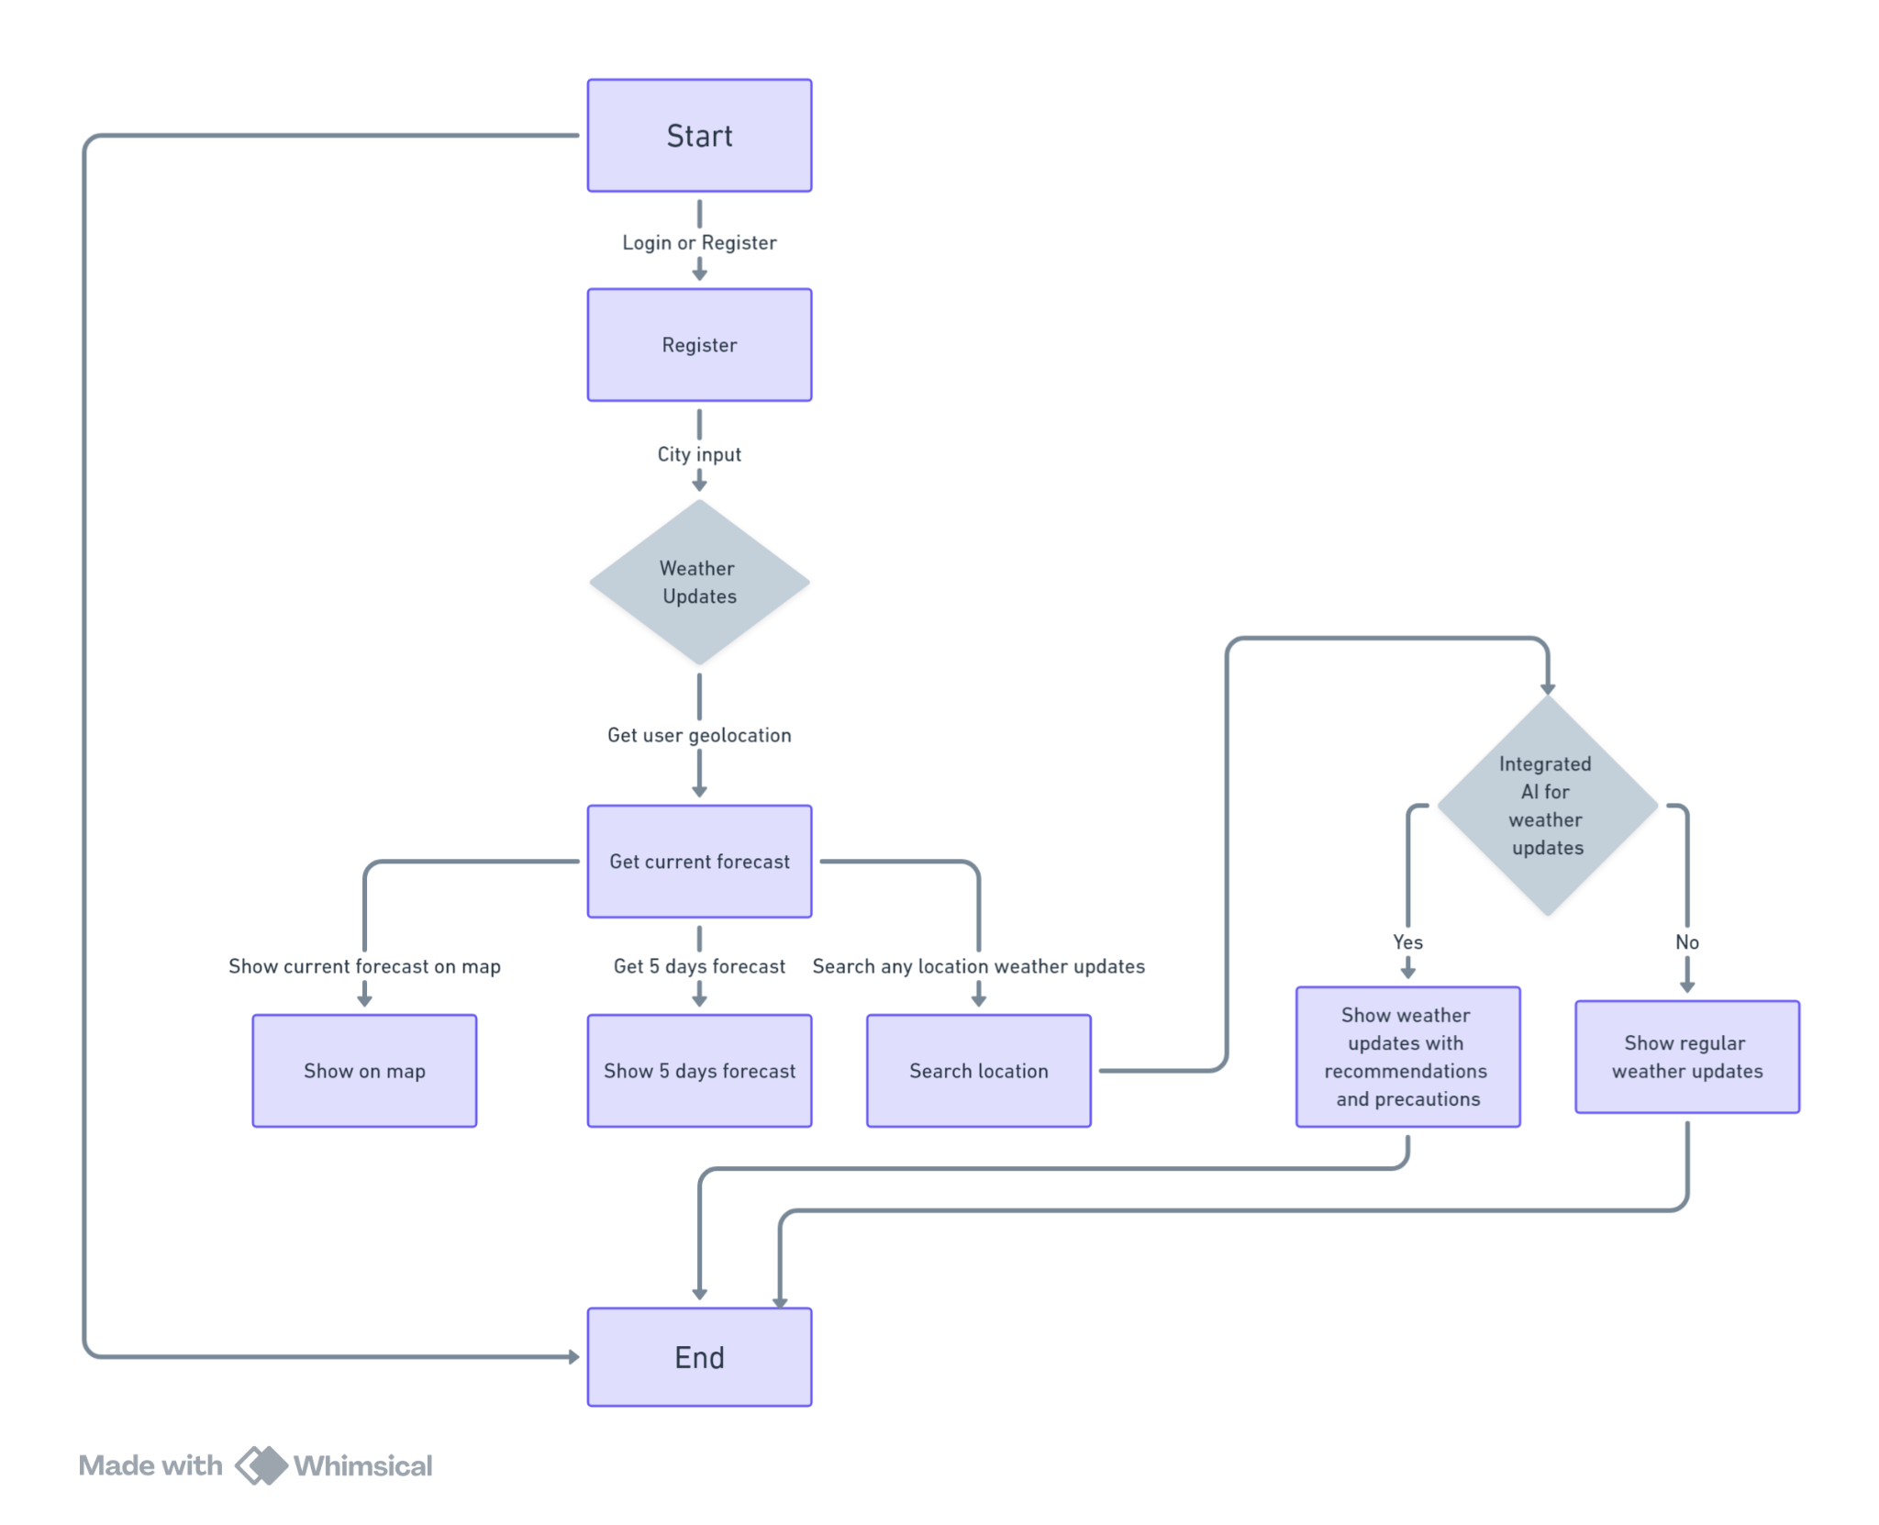
Flow Chart

Slide 13
Tools & Technologies To Be Used
Frontend:- React.js, Tailwind
APIs:- OpenWeatherMap, React Leaflet Map Component
Backend:- Node.js, Express.js
Authentication:- JWT, bcrypt
Database:- MongoDB

Slide 14
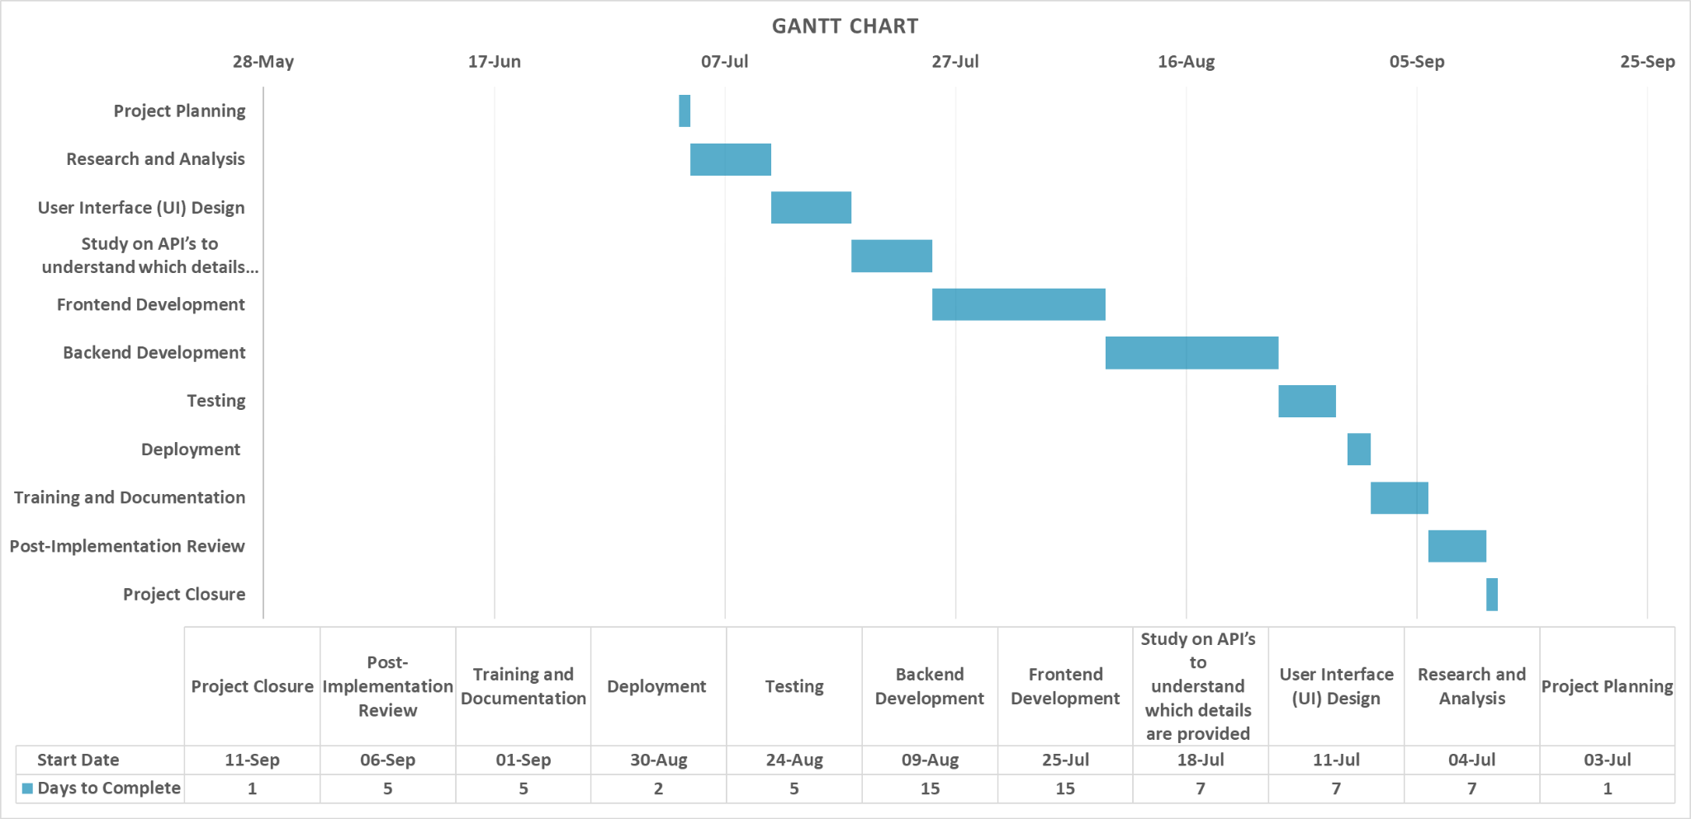
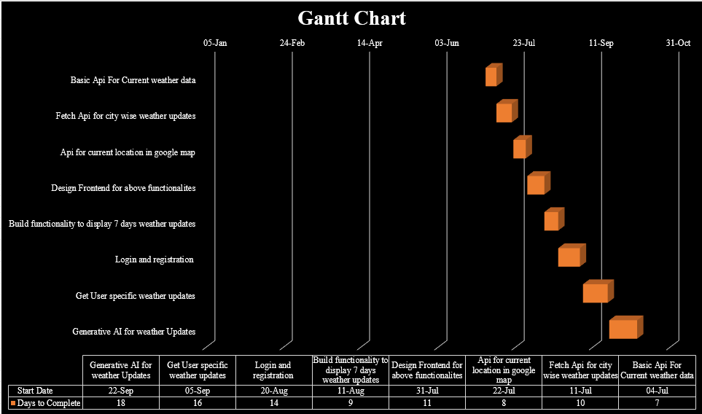
Gantt Chart

Slide 15
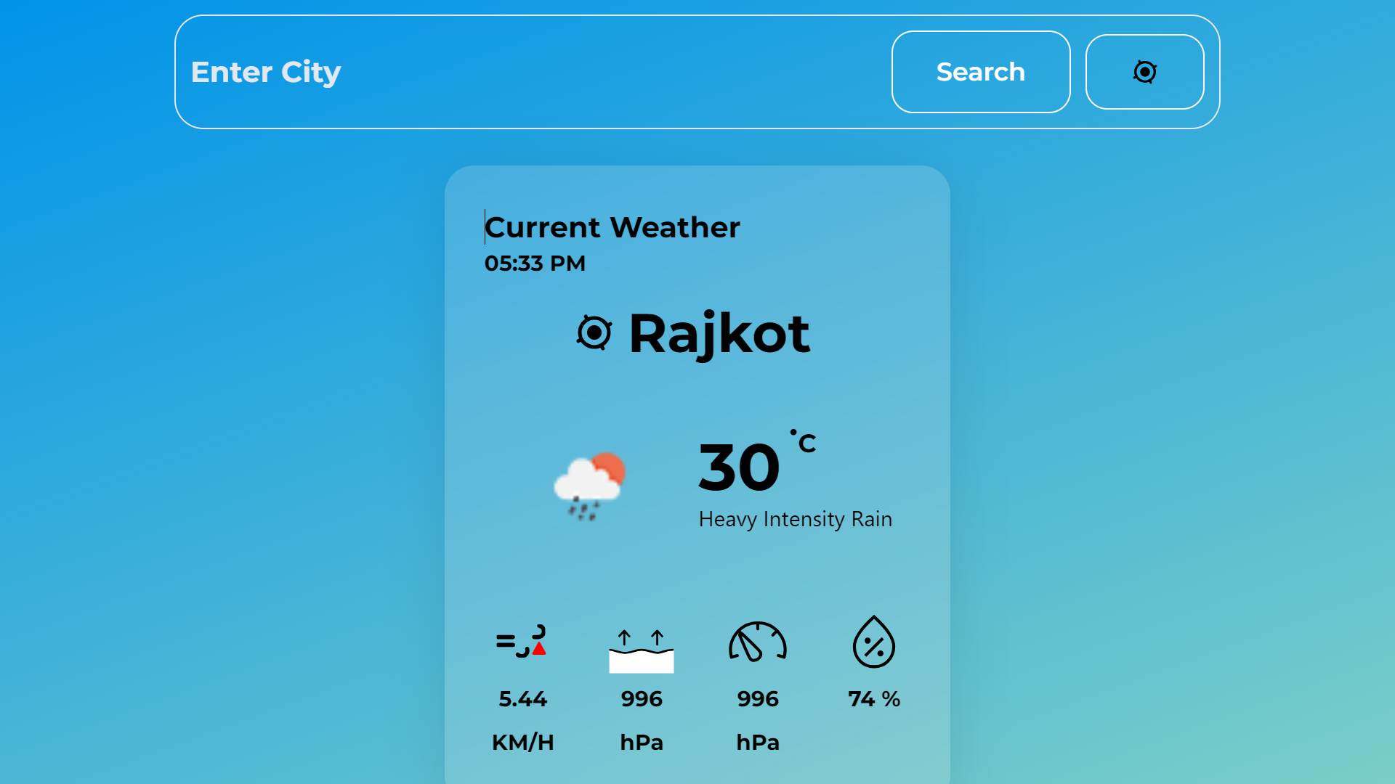
Expected Outcomes
Showing Current Weather

Slide 16
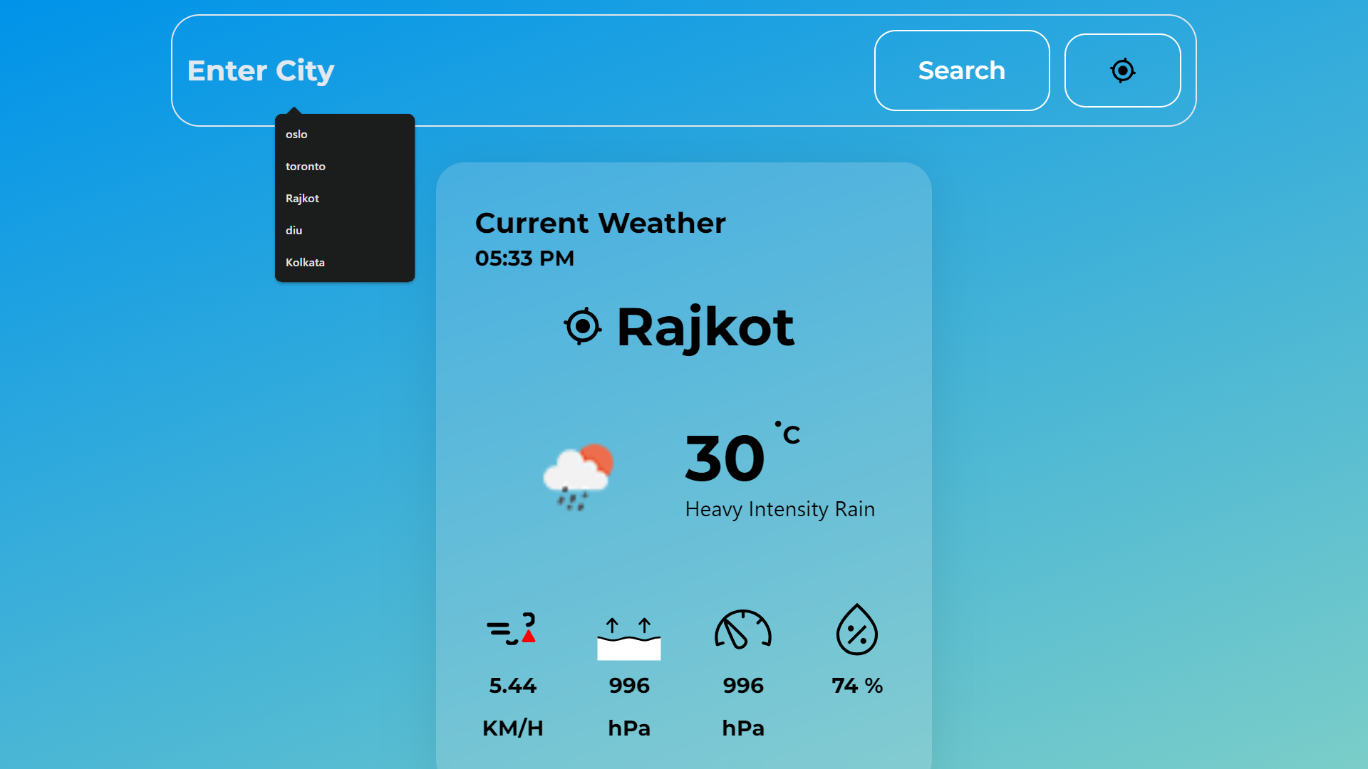
Expected Outcomes
Search Functionality

Slide 17
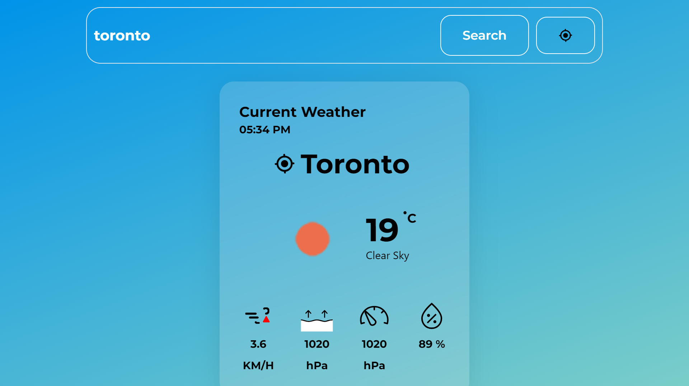
Expected Outcomes
Searched City Weather

Slide 18
References
https://openweathermap.org/api
https://developer.accuweather.com/accuweather-forecast-api/apis
https://www.weatherapi.com/
https://dribbble.com/shots/22126121-Weather-Web-App

Slide 19

.

